Slide 1
Classification of Wind Turbines
Based on the number of Rotor blades
Single Blade
Multi blade
Based on the Axis of rotation
Horizontal Axis Wind Turbine (HAWT)
Axis of rotation is parallel to the air stream (i.e. horizontal)
Eg: Blade type with one, two, or three blades, Multiple-blade,
Vertical Axis Wind Turbine (VAWT)
Axis of rotation is perpendicular to the air stream (i.e. vertical)
Eg: Drag and Lift turbine

Slide 2
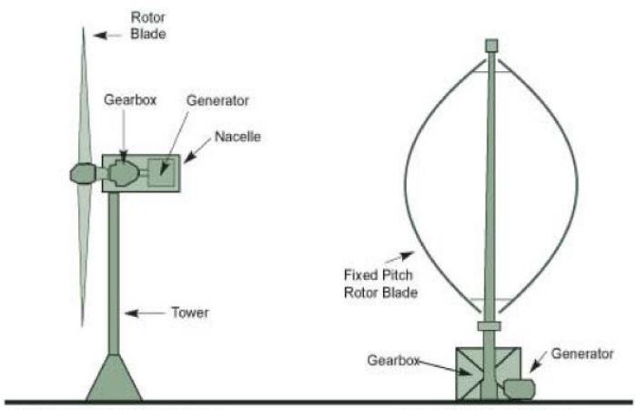
Classification of Wind Turbines
Horizontal Axis Wind Turbine (HAWT) Vertical Axis Wind Turbine (VAWT)

Slide 3
Horizontal Axis Wind Turbine (HAWT)
Horizontal-axis wind turbines (HAWT) have the main rotor shaft and electrical generator at the top of a tower, and must be pointed into the wind.
Most have a gearbox, which turns the slow rotation of the blades into a quicker rotation that is more suitable to drive an electrical generator. Since a tower produces turbulence behind it, the turbine is usually pointed upwind of the tower.
Turbine blades are made stiff to prevent the blades from being pushed into the tower by high winds. Additionally, the blades are placed a considerable distance in front of the tower and are sometimes tilted up a small amount.
The horizontal axis wind turbines are available in two types like the following.
Upwind Turbine
Downwind Turbine

Slide 4
Horizontal Axis Wind Turbine (HAWT)
Nacelle is placed at the top of the tower
Lift is the main force
Yaw mechanism is required
95% of the existing turbines are HAWTs
High efficiency

Slide 5
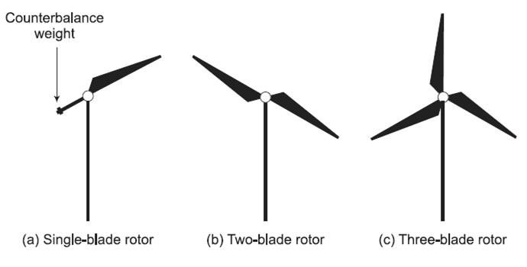
Horizontal Axis Wind Turbine (HAWT)
Three horizontal-axis wind turbine rotor configurations:
Single-blade with counterweight
Two-blade, and
Three-blade rotors
Multiple-Blade Turbines

Slide 6
HAWT - Types
Single-blade rotor
A rotor with one long blade and a counterbalance weight on the opposite side to keep the rotor dynamically balanced during rotation.​
Such designs reduce material cost but are uncommon because they suffer from higher vibration and fatigue loads, and the counterweight adds mechanical complexity.​
Two-blade rotor
A rotor with two blades placed opposite each other around the hub.​
Two-bladed turbines are lighter and can rotate faster, but they experience larger cyclic loads and can be noisier and less smooth in operation than three-blade designs.​
Three-blade rotor
The standard modern configuration with three evenly spaced blades around the hub.​
Three blades provide a good balance of aerodynamic efficiency, structural stability, and low noise, which is why most commercial wind turbines use this arrangement.

Slide 7
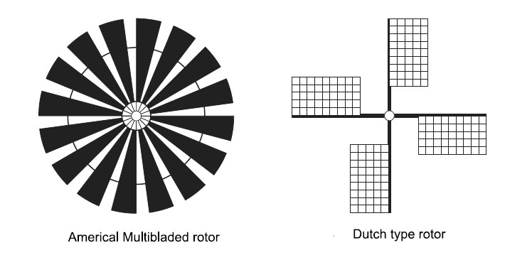
HAWT - Types
Multiple-Blade Turbines
They are low-speed rotors
Most suited for water lifting applications, which require high starting torque.
They can capture power even from very slow winds.
Such a turbine is usually mounted on a horizontal shaft
They have lower efficiency than that of blade (rotor) turbines
They demand very high towers

Slide 8
HAWT advantages
Variable blade pitch, which gives the turbine blades the optimum angle of attack. Allowing the angle of attack to be remotely adjusted gives greater control, so the turbine collects the maximum amount of wind energy for the time of day and season.
The tall tower base allows access to stronger wind in sites with wind shear. In some wind shear sites, every ten meters up, the wind speed can increase by 20% and the power output by 34%.
High efficiency, since the blades always move perpendicularly to the wind, receiving power through the whole rotation. In contrast, all vertical axis wind turbines, and most proposed airborne wind turbine designs, involve various types of reciprocating actions, requiring airfoil surfaces to backtrack against the wind for part of the cycle. Backtracking against the wind leads to inherently lower efficiency.

Slide 9
HAWT disadvantages
The tall towers and blades up to 90 meters long are difficult to transport. Transportation can now cost 20% of equipment costs.
Tall HAWTs are difficult to install, needing very tall and expensive cranes and skilled operators.
Massive tower construction is required to support the heavy blades, gearbox, and generator.
Reflections from tall HAWTs may affect side lobes of radar installations creating signal clutter, although filtering can suppress it.
Downwind variants suffer from fatigue and structural failure caused by turbulence when a blade passes through the tower's wind shadow (for this reason, the majority of HAWTs use an upwind design, with the rotor facing the wind in front of the tower).
HAWTs require an additional yaw control mechanism to turn the blades toward the wind.

Slide 10
Applications of horizontal axis wind turbines
These are the most frequently used wind turbines for commercial and industrial purposes due to their large power output and high efficiency.
These are mostly used in wind farms
Horizontal axis wind turbines achieve better power output & higher energy efficiency, so used in large-scale wind power plants & also for electricity generation.
In industrial plants, large-scale wind farms, or national projects, these wind turbines are most frequently seen. So, they are the perfect solution for the production of mass electricity.

Slide 11
Vertical Axis Wind Turbine (VAWT)
Drag may be created when the blade rotates into the wind.
Yaw mechanism is not required
Lower starting torque
Difficulty in mounting the turbine
Vertical-axis wind turbines (or VAWTs) have the main rotor shaft arranged vertically. Key advantages of this arrangement are that the turbine does not need to be pointed into the wind to be effective. This is an advantage on sites where the wind direction is highly variable.
VAWTs can utilize winds from varying directions.
Nacelle is placed at the bottom. With a vertical axis, the generator and gearbox can be placed near the ground, so the tower doesn't need to support it, and it is more accessible for maintenance.
Unwanted fluctuations in the power output. Drawbacks are that some designs produce pulsating torque.

Slide 12
VAWT advantages
A massive tower structure is less frequently used, as VAWTs are more frequently mounted with the lower bearing mounted near the ground.
Designs without yaw mechanisms are possible with fixed pitch rotor designs.
A VAWT can be located nearer the ground, making it easier to maintain the moving parts.
VAWTs have lower wind startup speeds than HAWTs. Typically, they start creating electricity at 6 M.P.H. (10 km/h).
VAWTs may have a lower noise signature.

Slide 13
VAWT disadvantages
Most VAWTs produce energy at only 50% of the efficiency of HAWTs in large part because of the additional drag that they have as their blades rotate into the wind.
While VAWTs' parts are located on the ground, they are also located under the weight of the structure above it, which can make changing out parts nearly impossible without dismantling the structure if not designed properly.
Having rotors located close to the ground where wind speeds are lower due to wind shear, VAWTs may not produce as much energy at a given site as a HAWT with the same footprint or height.
Because VAWTs are not commonly deployed due mainly to the serious disadvantages mentioned above, they appear novel to those not familiar with the wind industry. This has often made them the subject of wild claims and investment scams over the last 50 years.

Slide 14
VAWT Applications
Used in small wind projects
Used in residential applications
These turbines are used to generate power even in not stable weather conditions like gusty wind & turbulence.

Slide 15
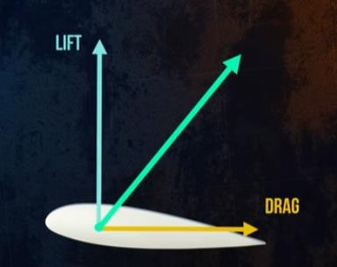
Based on the type of active force that makes the turbines turn
When air flows around an object, two forces act on the object, drag and lift .
Lift : perpendicular to the air flow
Drag : along the direction of air flow
Turbines that work based on either of these forces are lift turbines and drag turbines.

Slide 16
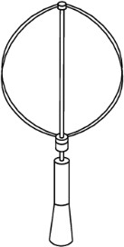
Lift Turbines
The lift blade design make use of the same principle that enables aeroplanes, kites and birds to fly.
When air flows past the blade, a wind speed and pressure differential is created between the upper and lower blade surfaces.
The pressure at the lower surface is greater and thus acts to “lift” the blade.
When blades are attached to a central axis, like a wind turbine rotor, the lift is translated into rotational motion.

Slide 17
Lift Turbines
Lift-powered wind turbines have much higher rotational speeds than drag types.
Suitable for generating electricity.
Lift devices are more efficient and turn faster than wind.
They are able to benefit from high power densities available in strong winds.
Eg: Darrieus turbine

Slide 18
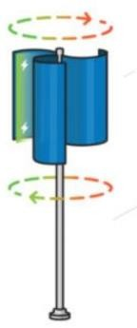
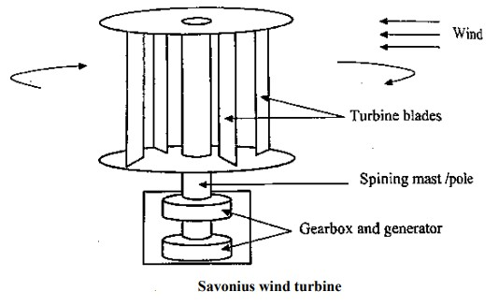
Drag Turbines

Slide 19
Drag Turbines
For the drag design, the wind literally pushes the blades out of the way.
The torque of a drag turbine is due to the difference in pressure between the concave and convex surfaces of the blades and by the recirculation of wind coming from behind the convex surface
Drag devices are less efficient and turn slower than wind.
They produce high torque and thus are suitable for pumping applications.
At high wind speeds they spill wind instead of producing more energy.
Thus, they do not benefit from high energy density available in wind.
Eg:savonius turbine

